Slide 1
Java Multimedia: Images, Animation, Audio and Video
Outline
30.1 Introduction
30.2 Loading, Displaying and Scaling Images
30.3 Loading and Playing Audio Clips
30.4 Animating a Series of Images
30.5 Animation Issues
30.6 Customizing Applets via the HTML param Tag
30.7 Image Maps
30.8 Internet and World Wide Web Resources

Slide 2
Objectives
In this chapter, you will learn:
  To understand how to get and display images.
  To be able to create animations from sequences of images; to control animation speed and flicker.
  To be able to get, play, loop and stop sounds.
  To be able to monitor the loading of images with class MediaTracker; to create image maps.
  To customize applets with the param tag.

Slide 3
30.1 Introduction
Revolution in computer industry
  Before, computers used for high-speed calculations
  Now, data manipulation important
Multimedia
  "sizzle" of Java - images, sound, video
  CDs, DVDs, video cards
  Demands extraordinary computing power
    Fast processors making multimedia possible
Java
  Has built-in multimedia capabilities
    Most programming languages do not
  Develop powerful multimedia applications

Slide 4
30.2 Loading, Displaying and Scaling Images
Java Multimedia
  Graphics, images, animations, sounds, and video
    Begin with images
Class Image (java.awt)
  Abstract class, cannot create an object directly
    Must request that an Image be loaded and returned to you
  Class Applet (superclass of JApplet) has this method
    getImage( imageLocation, filename );
    imageLocation - getDocumentBase() - URL (address) of HTML file
    filename - Java supports .gif and .jpg (.jpeg)

Slide 5
30.2 Loading, Displaying and Scaling Images (II)
Displaying Images with drawImage
  Many overloaded versions
  g.drawImage( myImage, x, y, ImageObserver );
    myImage - Image object
    x,y - coordinates to display image
    ImageObserver - object on which image is displayed
      Use "this" to indicate the applet
      Can be any object that implements ImageObserver interface
  g.drawImage( myImage, x, y, width, height, ImageObserver );
    width and height - dimensions of image (automatically scaled)
      getWidth(), getHeight() - return dimensions of applet

Slide 6
30.2 Loading, Displaying and Scaling Images (III)
Class ImageIcon
  Not an abstract class (can create objects)
  Example constructor
    private ImageIcon myIcon;
    myIcon = new ImageIcon( "myIcon.gif" );
Displaying Icons with method paintIcon
  myIcon.paintIcon( Component, Graphics, x, y )
  Component - Component object on which to display image (this)
  Graphics - Graphics object used to render image (g)
  x, y - coordinates of Icon

Slide 7
30.2 Loading, Displaying and Scaling Images (IV)
Usage
  ImageIcons are simpler than Images
    Create objects directly
    No need for ImageObserver reference
  However, cannot scale ImageIcons
Scaling
  Use ImageIcon method getImage
    Returns Image reference
    This can be used with drawImage and be scaled

Slide 8
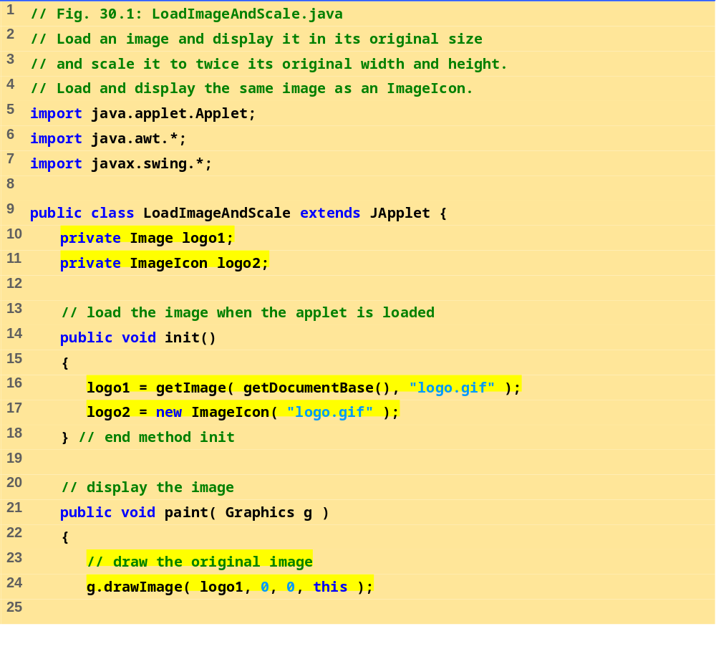
LoadImage-AndScale.java (Part 1 of 2)

Slide 9
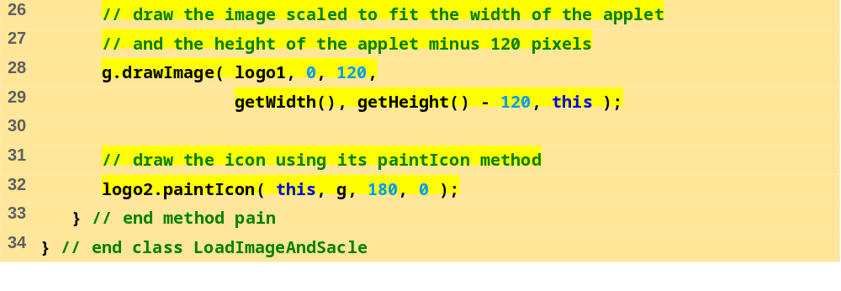

LoadImage-AndScale.java (Part 2 of 2)
Program Output

Slide 10
30.3 Loading and Playing Audio Clips
Audio clips
  Require speakers and a sound board
  Sound engine - plays audio clips
    Supports .au, .wav, .aif, .mid
    Java Media Framework supports additional formats
Playing audio clips
  play method in Applet
  Plays clip once, marked for garbage collection when finished
  play( location, soundFileName );
    location - getDocumentBase (URL of HTML file)
  play( soundURL );
  soundURL - URL that contains location and filename of clip

Slide 11
30.3 Loading and Playing Audio Clips (II)
Playing audio clips
  Method play from AudioClip interface
  More flexible than Applet method play
    Audio stored in program, can be reused
  getAudioClip
    Returns reference to an AudioClip
    Same format as Applet method play
      getAudioClip( location, filename )
      getAudioClip( soundURL )
  Once AudioClip loaded, use methods
    play - plays audio once
    loop - continuous loops audio in background
    stop - terminates clip that is currently playing

Slide 12
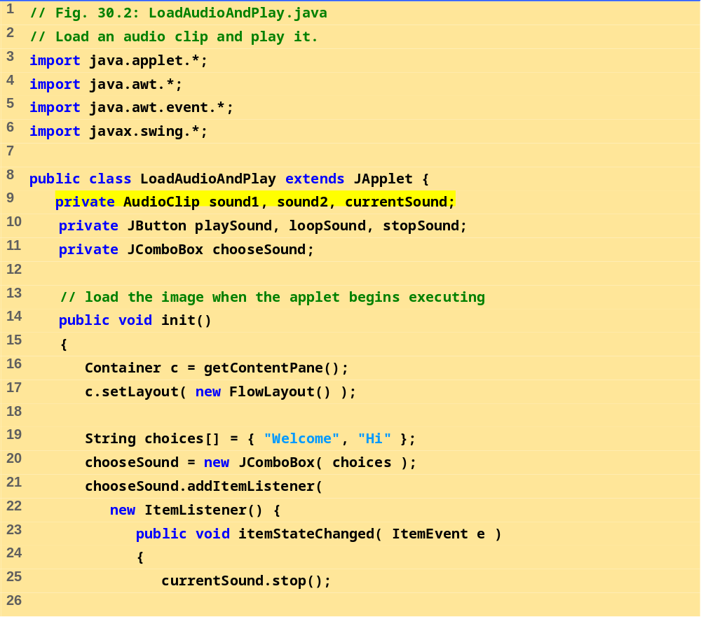
LoadAudioAndPlay.java (Part 1 of 3)

Slide 13
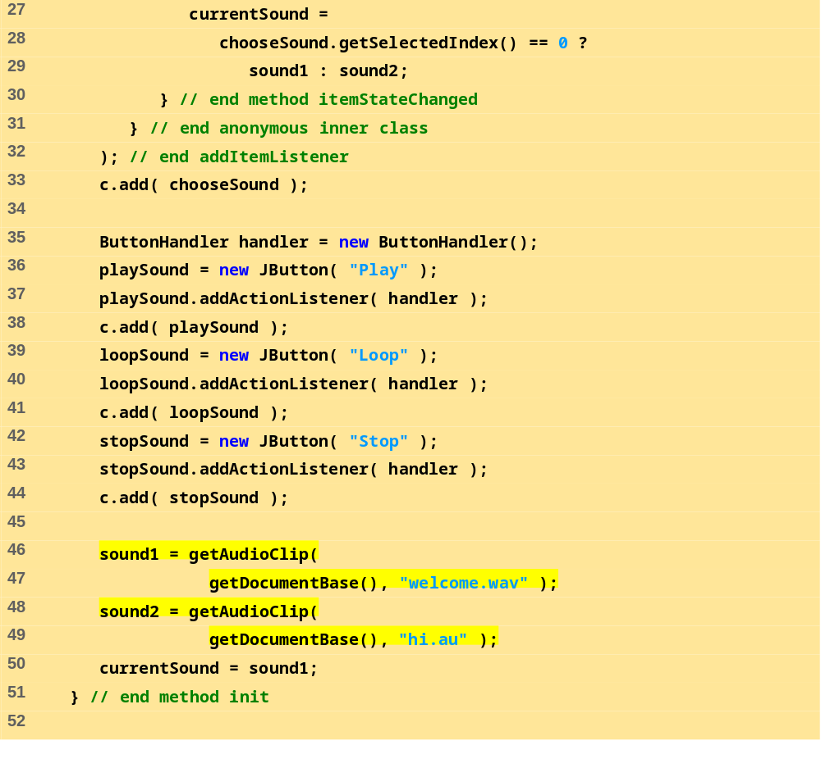
LoadAudioAndPlay.java (Part 2 of 3)

Slide 14
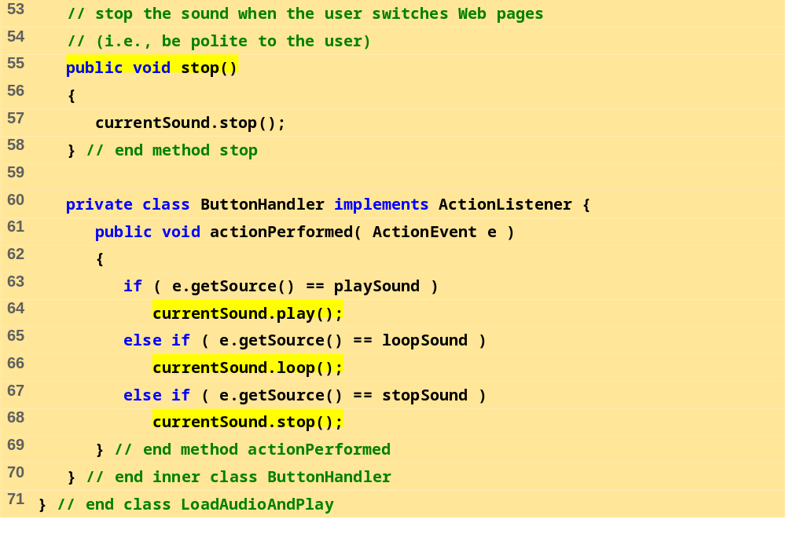
LoadAudioAndPlay.java (Part 3 of 3)

Slide 15
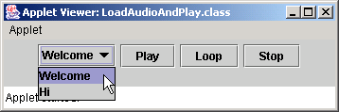
Program Output

Slide 16
30.4 Animating a Series of Images
Following example
  Use a series of images stored in an array
  Use same techniques to load and display ImageIcons
Class Timer
  Generates ActionEvents at a fixed interval in milliseconds
    Timer ( animationDelay, ActionListener );
    ActionListener - ActionListener that will respond to ActionEvents
  Methods
    start
    stop
    restart
    isRunning

Slide 17
30.4 Animating a Series of Images (II)
Method repaint
  Calls update, which calls paintComponent
    Subclasses of JComponent should draw in method paintComponent
    Call superclass's paintComponent to make sure Swing components displayed properly
View area
  Width and height specify entire window, not client area
  Dimension objects
    Contain width and height values
    myDimObject = new Dimension( 100, 200 );
    myDimObject.width

Slide 18
30.4 Animating a Series of Images (III)
getImageLoadStatus
  ImageIcon method
    Determines if image is completely loaded into memory
    Only complete images should be displayed (smooth animation)
  If loaded, returns MediaTracker.COMPLETE
  MediaTracker
    Can determine when images are loaded, or force program to wait if not
    ImageIcon creates our MediaTracker for us

Slide 19
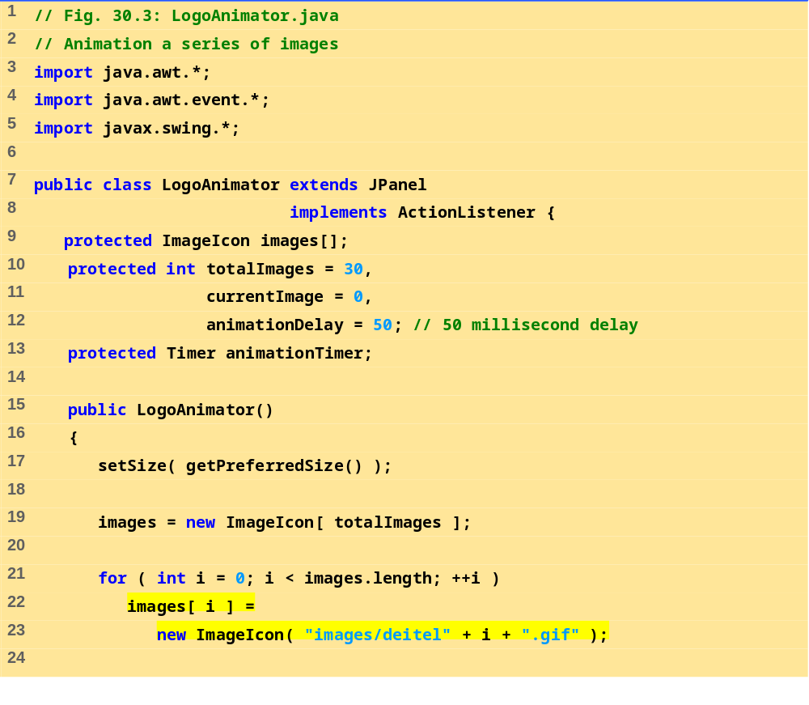
LoopAnimator.java (Part 1 of 4)

Slide 20
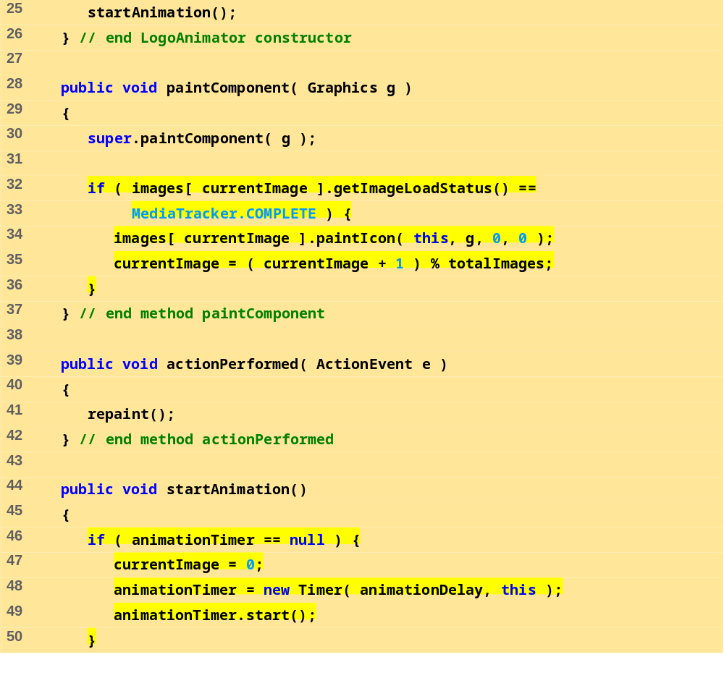
LoopAnimator.java (Part 2 of 4)

Slide 21
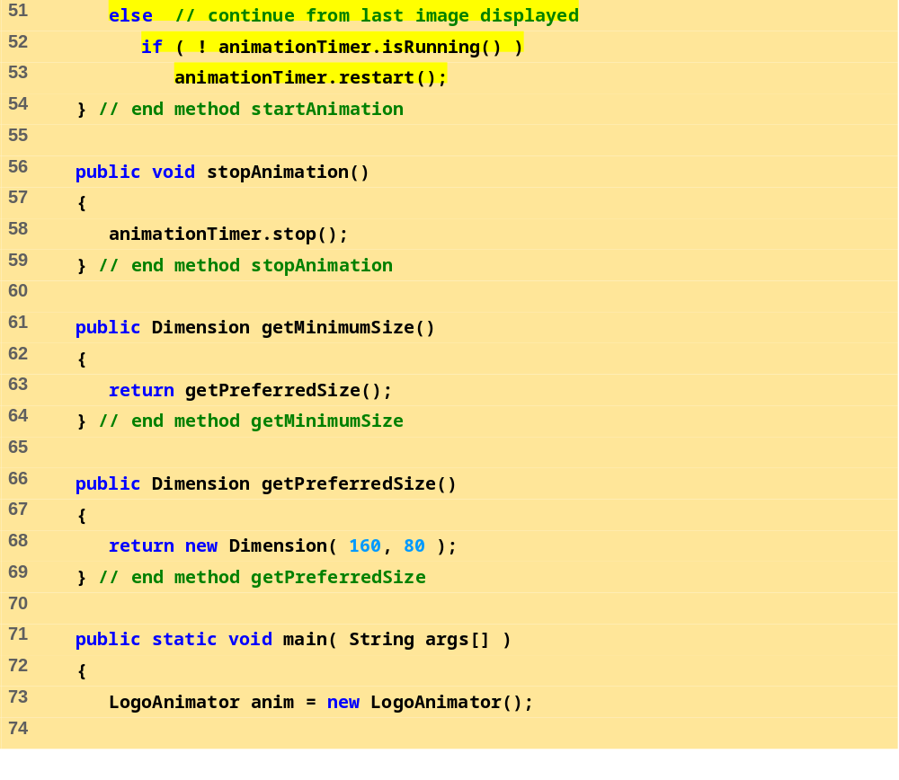
LoopAnimator.java (Part 3 of 4)

Slide 22
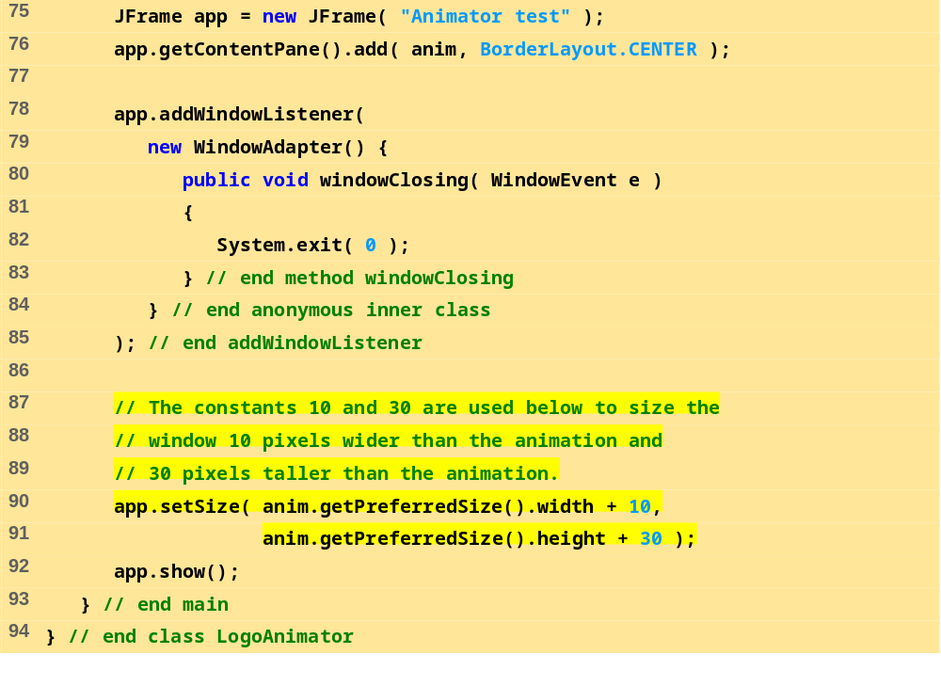
LoopAnimator.java (Part 4 of 4)

Slide 23




Program Output

Slide 24
30.5 Animation Issues
Storing images
  Interlaced/non-interlaced formats
    Specifies order in which pixels are stored
    Non-interlaced - pixels stored in order they appear on screen
      Image appears in chunks from top to bottom as it is loaded
    Interlaced - pixels stored in rows, but out of order
      Image appears to fade in and become more clear
Animation flickers
  Due to update being called in response to repaint
  In AWT GUI components
    Draws filled rectangle in background color where image was
    Draw image, sleep, clear background (flicker), draw next image...
  Swing's JPanel overrides update to avoid this

Slide 25
30.5 Animation Issues (II)
Double buffering
  Used to smooth animations
  Program renders one image on screen
    Builds next image in off-screen buffer
  When time to display next image, done smoothly
    Partial images user would have seen (while image loads) are hidden
    All pixels for next image displayed at once
  Space/Time tradeoff
    Reduces flicker, but can slow animation speed and uses more memory
  Used by Swing GUI components by default

Slide 26
30.6 Customizing Applets via the HTML param Tag
Applets
  Customize through parameters in HTML file that invokes it
  <html>
  <applet code="LogoApplet.class" width=400 height=400>
  <param name="totalimages" value="30">
  <param name="imagename" value="deitel">
  <param name="animationdelay" value="200">
  </applet>
  </html>
  Invokes applet LogoApplet
  param tags
    Each has a name and a value
    Use Applet method getParameter (returns a String)
      parameter = getParameter( "animationdelay" );

Slide 27
30.6 Customizing Applets via the HTML param Tag (II)
Following example
  Use the LogoAnimator class as before, but modified slightly
  Create Applet LogoApplet
    Takes parameters
    Creates LogoAnimator object using the parameters
    Plays animation

Slide 28
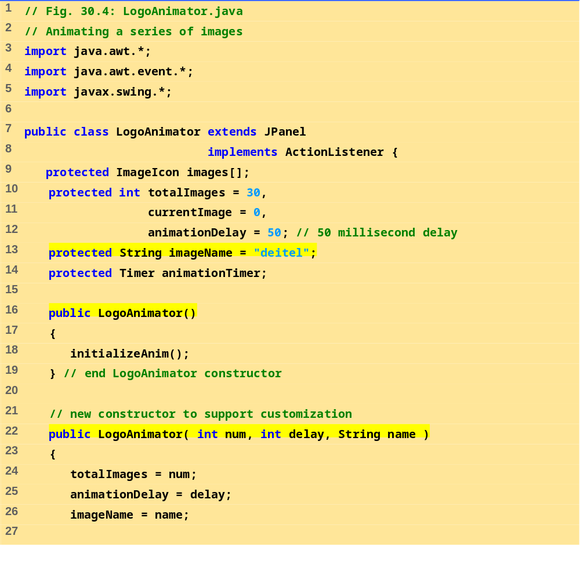
LogoAnimator.java (Part 1 of 5)

Slide 29
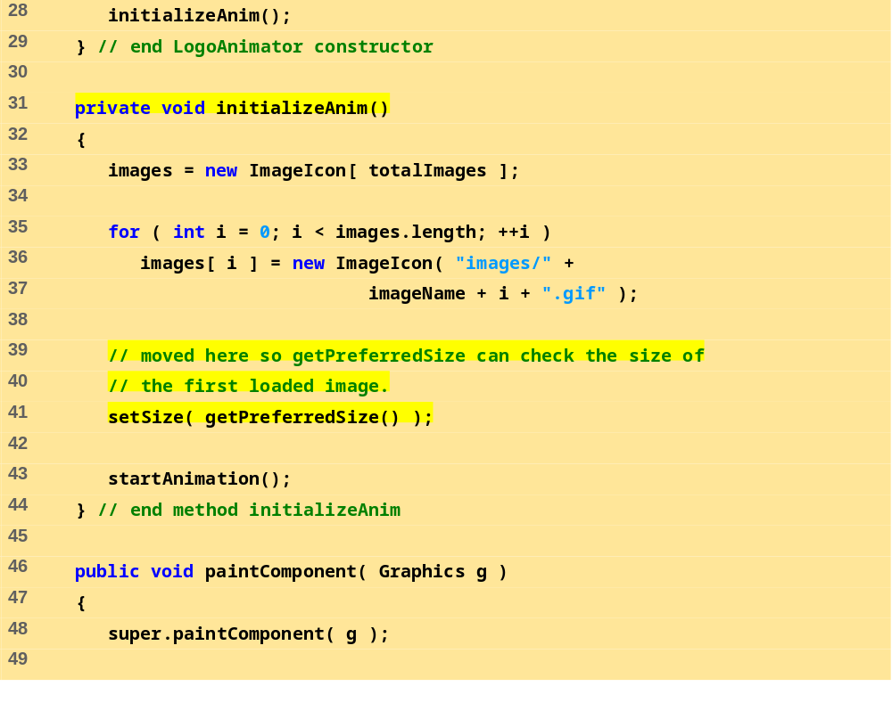
LogoAnimator.java (Part 2 of 5)

Slide 30
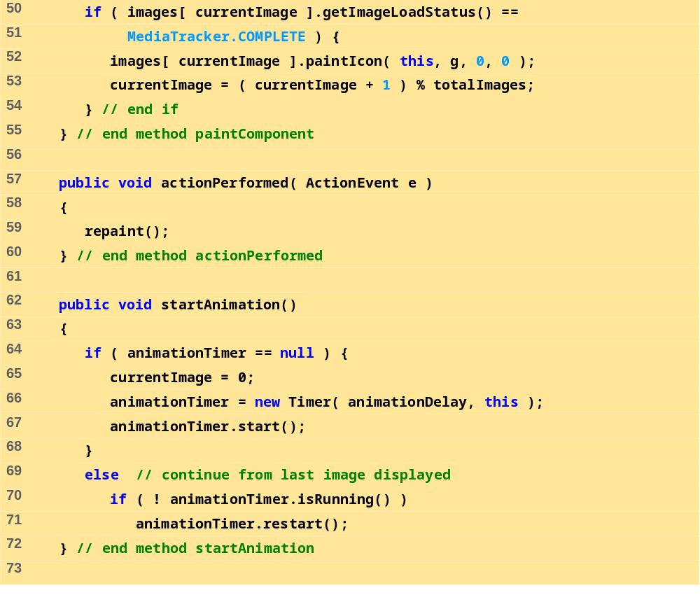
LogoAnimator.java (Part 3 of 5)

Slide 31
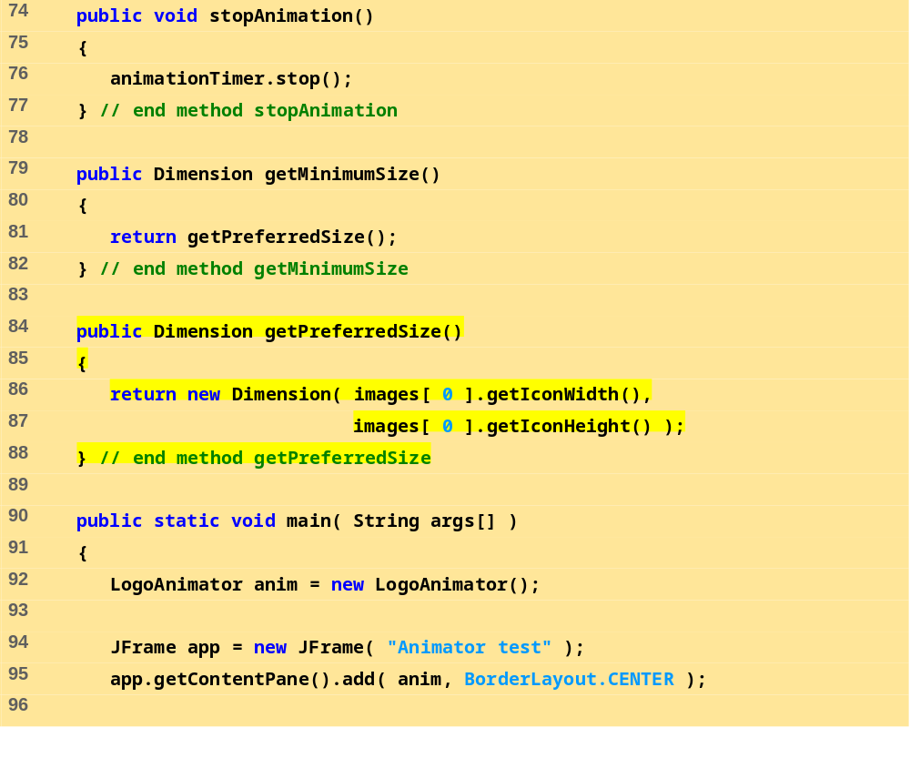
LogoAnimator.java (Part 4 of 5)

Slide 32
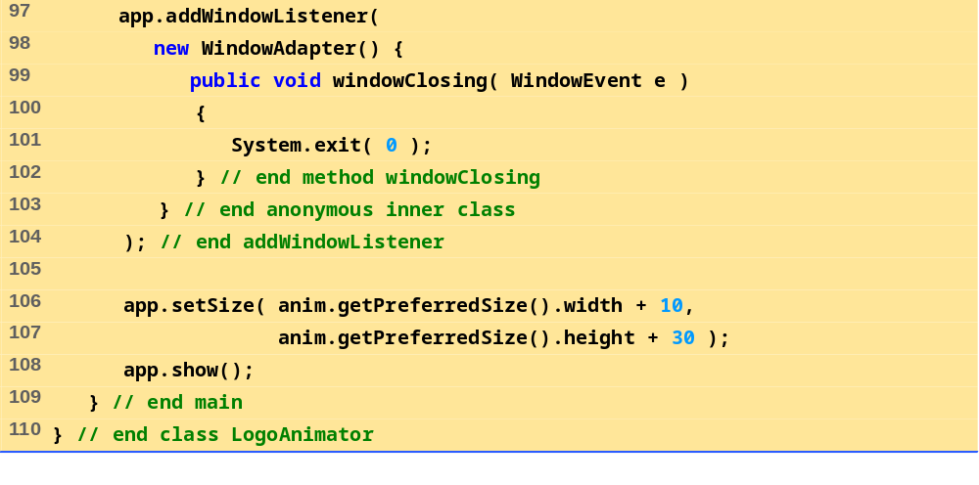
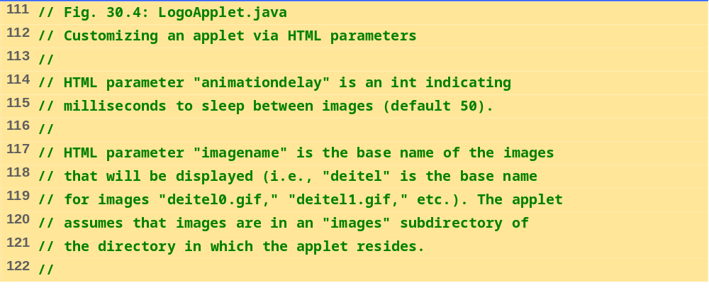
LogoAnimator.java (Part 5 of 5)
LogoApplet.java (Part 1 of 3)

Slide 33
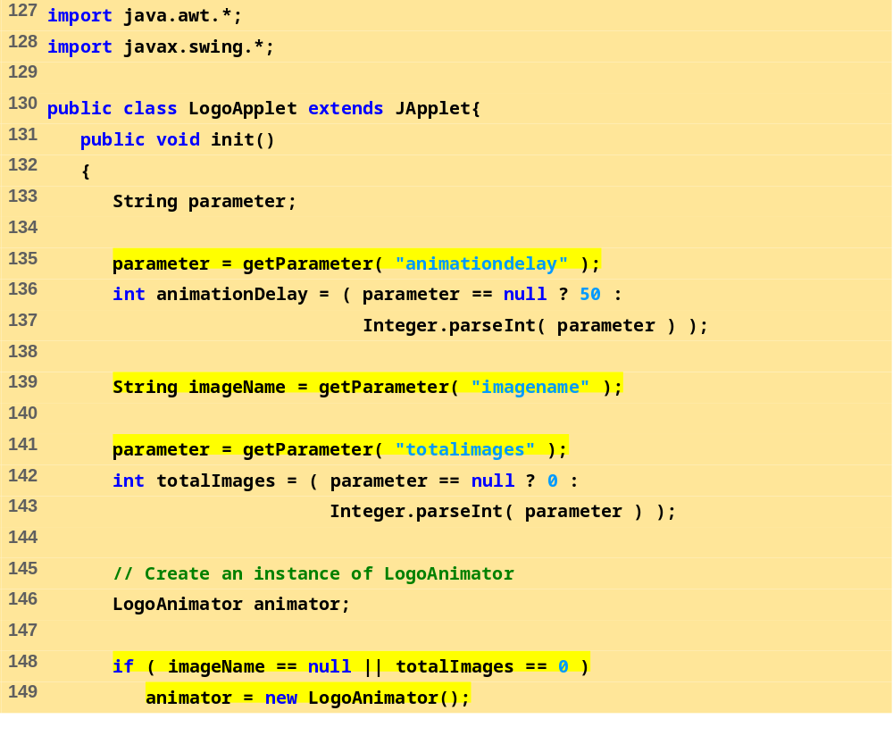
LogoApplet.java (Part 2 of 3)

Slide 34
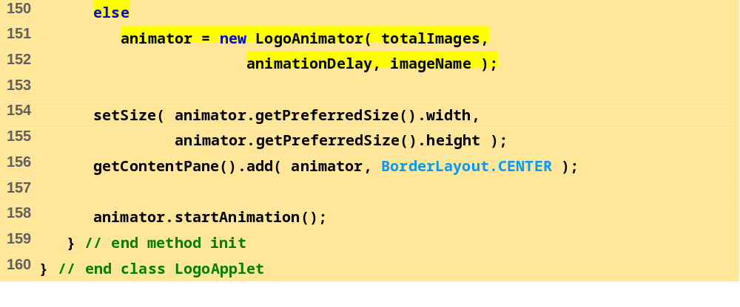




LogoApplet.java (Part 3 of 3)
Program Output

Slide 35
30.7 Image Maps
Image map
  Image that has hot areas
    User can click to accomplish a task
  Bubble help
    When mouse over particular point in screen, small message displayed in status bar
In the following example
  Load several images
  Use event handler mouseMoved to find x-coordinate
  Based on the x-coordinate, display a message

Slide 36
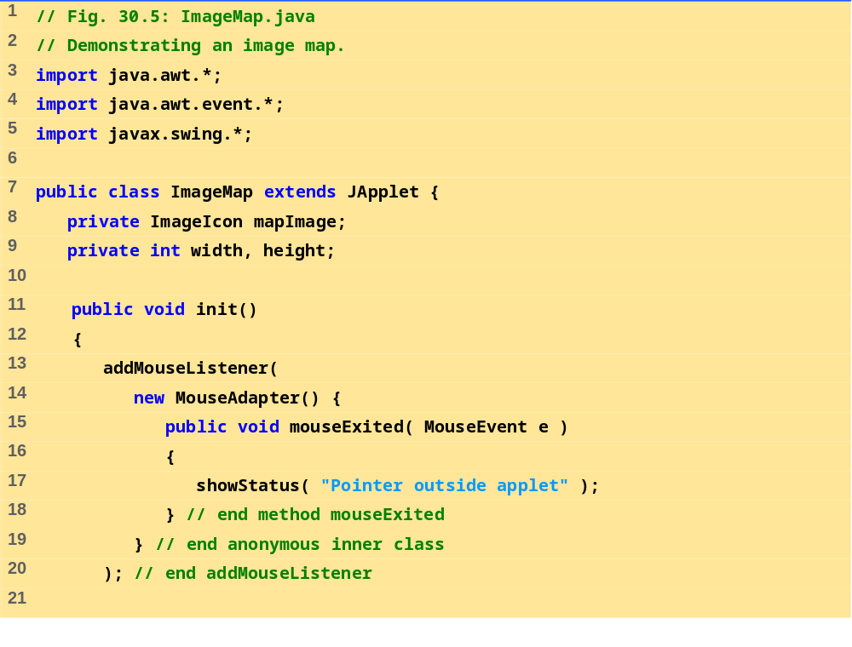
ImageMap.java (Part 1 of 3)

Slide 37
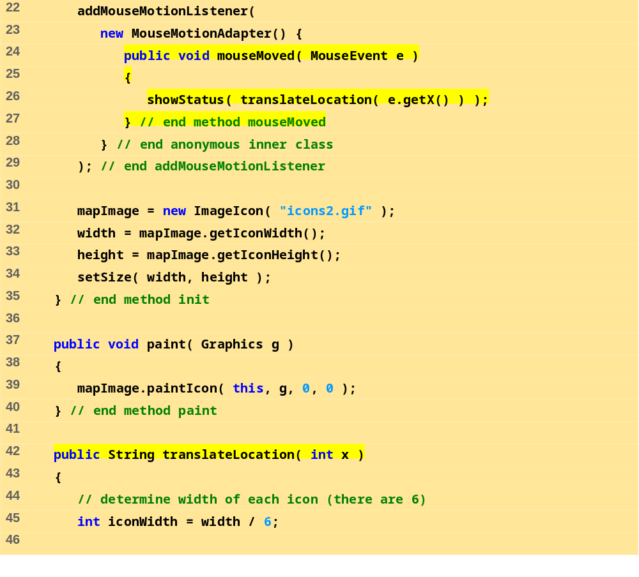
ImageMap.java (Part 2 of 3)

Slide 38
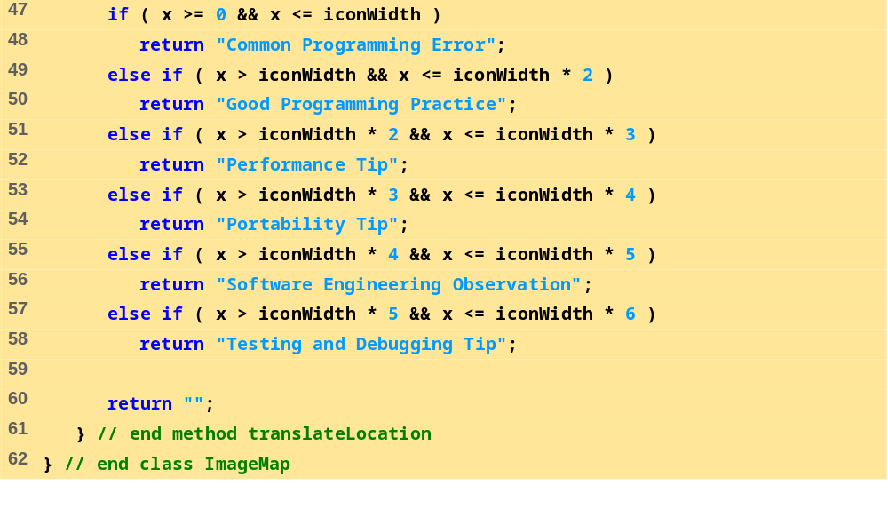
ImageMap.java (Part 3 of 3)

Slide 39
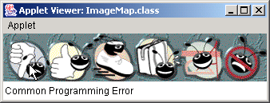

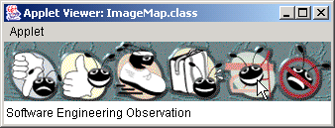
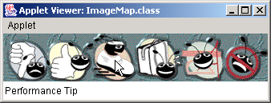

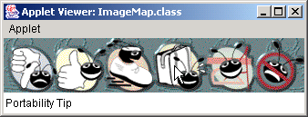
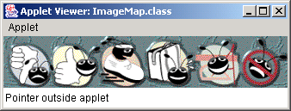
Program Output

Slide 40
30.8 Internet and World Wide Web Resources
Internet and web resources for multimedia related sites.
  http://www.nasa.gov/gallery/index.html
    The NASA multimedia gallery
  http://sunsite.sut.ac.jp/multimed/
    The Sunsite Japan Multimedia Collection
  http://www.anbg.gov.au/anbg/index.html
    The Australian National Botanic Gardens Web site provides links to sounds of many animals.

